Slide 1
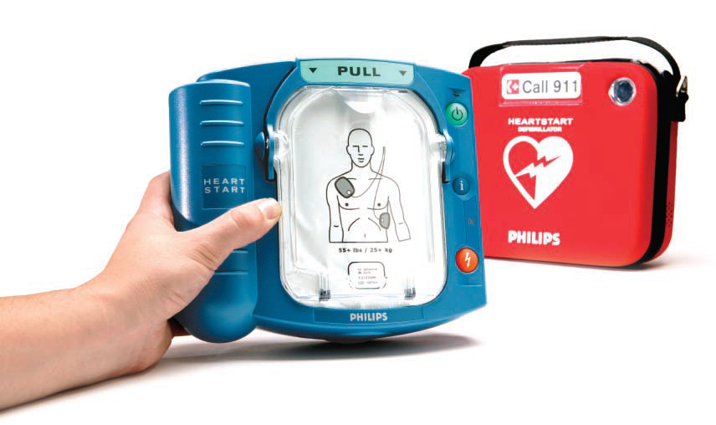
Defibrillator Program
Awareness
Facilities Services Version

Slide 2
Defibrillator Facts
Usually referred to as the “AED”. This stands for Automated External Defibrillator.
The unit completes self tests daily and will chirp if there is an issue to address

Slide 3
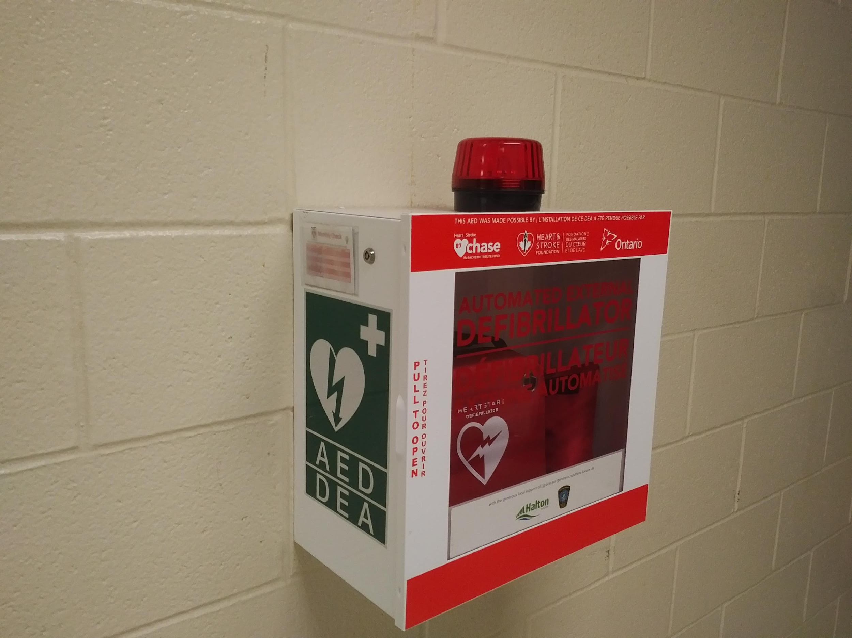
Access to Defibrillator
Units are usually located by the main entrance of a building, or sometimes by the school gymnasium due to after school rentals.
Ensure you are aware of the AED location in your school!
Units are housed within a cabinet with a clear door.
An alarm will sound or flashing light will blink when the door is opened. The
alarm will turn off when the door is closed.

Slide 4
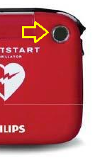
School Monthly Checks
The Head Caretaker at each school is responsible for completing monthly “Green Light Checks”
How to do a monthly “Green Light Check”: Without having to open the cabinet door… Look to the top right corner of the unit and you will see a flashing green light (approx. every 5 seconds).
If the unit does not have a flashing light or is making a chirping sound, please contact the Health & Safety Department or your Field Supervisor immediately.

Slide 5
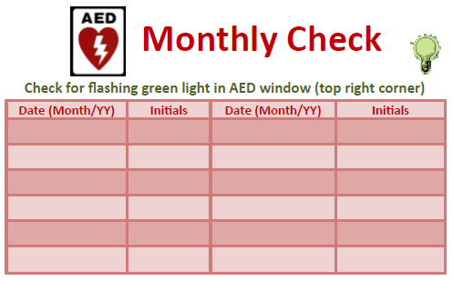
Inspection Card
An inspection card is located on the outside of the cabinet to record inspection completion.

Slide 6
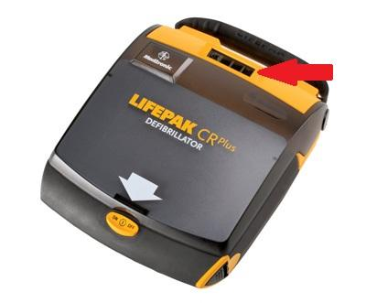
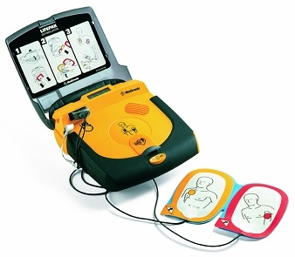
Lifepak Model
Please be aware that there are TWO Lifepak AED models within the HDSB that look like the ones pictured below. One is located on the 2nd floor of Frontenac PS. The other is in the main entrance of Oakville Trafalgar HS.
They do not have a flashing green light, but rather a grey digital screen with the word “OK” shown here next to the red arrow:
Notes:
Frontenac PS (2nd floor unit)
Oakville Trafalgar HS (Main Office)

Slide 7
More Information...
An extended version of this PowerPoint titled “Defibrillator Awareness” is available on the myHDSB Health & Safety website, which includes additional general information on Defibrillators and how they operate.

