Slide 1
LOCKOUT/TAGOUT (LOTO)

Slide 2
Lock out/Tag out Definitions
Lock out:
The placement of a lock on a lockout (energy isolating) device in accordance with an established procedure.
Indicates that the machine or equipment is not to be operated until removal of the lock and tag.
Tag out:
The placement of a warning tag on a lockout (energy isolating) device and/or lock.
Serves as a communication measure to tell others that the machine or equipment is out of service.
The tag should include the name of the person performing the lock-out tag-out as well as the date it was taken out of service.

Slide 3
When To Perform Lock Out/Tag Out
Reg. 851 (Section 76.(a)(b)) states that: “where the starting of a machine, transmission machinery, device or thing may endanger the safety of a worker, control switches or other control mechanisms shall be locked out; and other effective precautions necessary to prevent any starting shall be taken.”
Lock-out/Tag-out should be performed whenever a machine or piece of equipment is cleaned, maintained, adjusted or repaired.

Slide 4
Why Perform a Lock-Out?
A lock-out is performed to protect workers from injury due to unintentional release of energy while taking out of service or working on any machine, device or thing.
Sources of energy include: mechanical, electrical, chemical, pneumatic, hydraulic or thermal.

Slide 5
Mechanical Energy Hazards
Mechanical energy:
- is energy in an object due to its motion or position, or both.
Kinetic – in motion
Energy from moving parts can cause
Amputations
Lacerations
Fractures
Loss of life
Potential – stored
Stored potential energy can be released during work causing injury or death
Energy stored in machinery
Weights & Springs
Pistons under pressure
Hydraulic controls

Slide 6
Electrical Energy Hazards
Electrical energy:
is energy that is caused by moving electric charges.
Electrical burns:
Are the result of the electric current flowing in the tissues and may be either skin deep or may affect deeper layers (muscles, bones, etc.) or both.
Arc burns:
Are the result of high temperatures produced by electric arcs or by explosions close to the body causing burns and blisters.
Thermal contact burns:
Normally experienced from the skin contacting hot surfaces of overheated electric conductors, conduits, or other energized equipment.

Slide 7
Chemical Energy Hazards
Chemical energy:
is energy stored in the bonds of chemical compounds (atoms and molecules).
Chemicals have energy that can
Start fires
Cause skin burns
Generate harmful gases or fumes

Slide 8
Pneumatic Energy Hazards
Pneumatic energy:
pertains to the power related to pressurized air.
the pressure can be relatively static or in motion through tubing or hoses.
Injuries associated with pneumatic energy:
Eye injuries due to released pressure or blown debris.
Skin abrasions/punctures when exposed to high pressure fluid stream.
Unexpected machine motion due to Pneumatic pressure acting on machine components. Such actions could result in lacerations, pinching, crushing, or amputation.

Slide 9
Hydraulic energy:
is what is produced by the water which is stored in reservoirs and lakes at a high altitude (so that it has gravitational potential energy).
Thermal energy:
is the energy that comes from heat.

Slide 10
First Step in LOTO
Know your equipment!
What are the energy sources & hazards
Where are the sources of energy coming from (isolation points)
What equipment is needed for the LOTO
What is procedure for LOTO

Slide 11
Lock Out/Tag Out Kit Items
Tech Basic LOTO kit contains:
1 - 120/277V Clamp-On Single Pole Breaker Lockout w/cleat
1 - 480/600V Clamp-On Breaker Lockout w/cleat
1 - Universal Multi-pole Breaker Lockout
2 - 1" Group Lockout Hasps
2 - Heavy Duty Lockout Tags w/ Nylon Cable Ties
1- Large Plug Lockout
Caretaker Basic LOTO kit contains:
Clamp-On Single Pole Breaker Lockout
Tags
Padlock

Slide 12
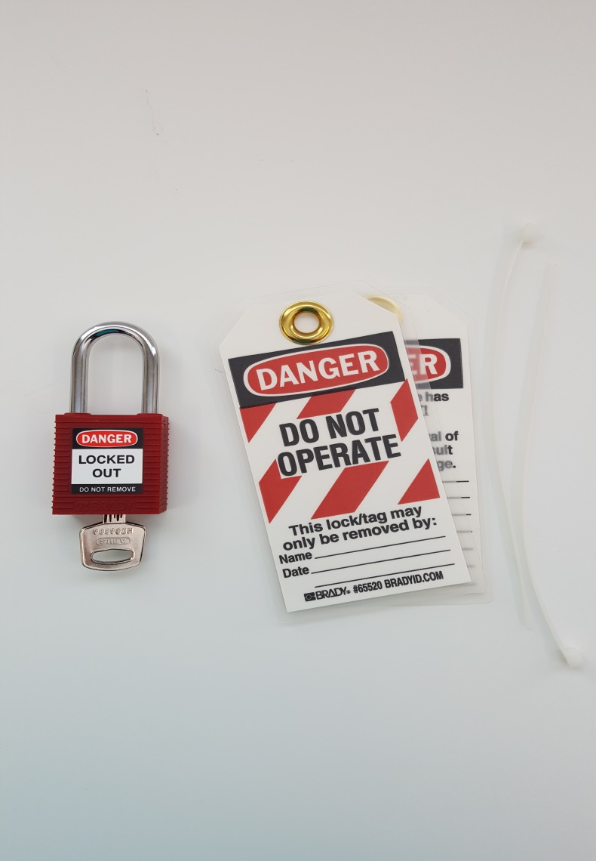
Locks & Tags
Tech teachers are given their own padlock.
Keys must be kept in a safe place because replacement keys are not available.

Slide 13
Small/Large Plug Lockout

Slide 14
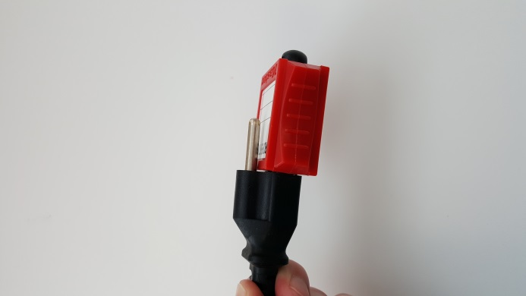
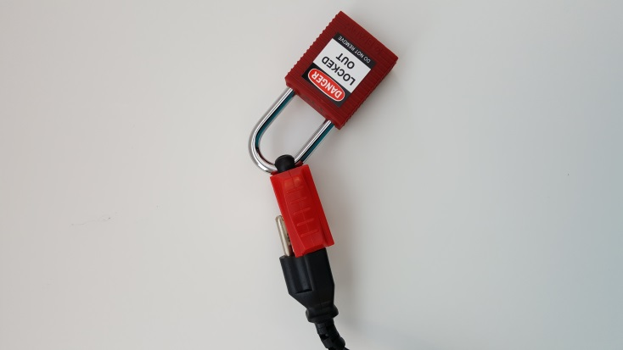
Small/Large Plug Lockout
1.
2.
3.

Slide 15
Large Plug Lockout

Slide 16
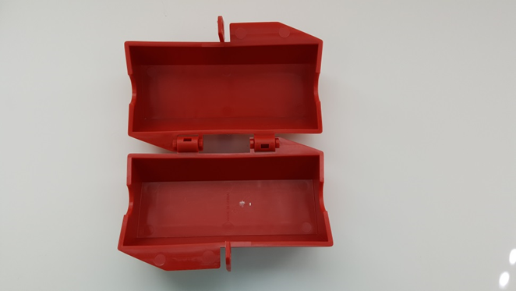
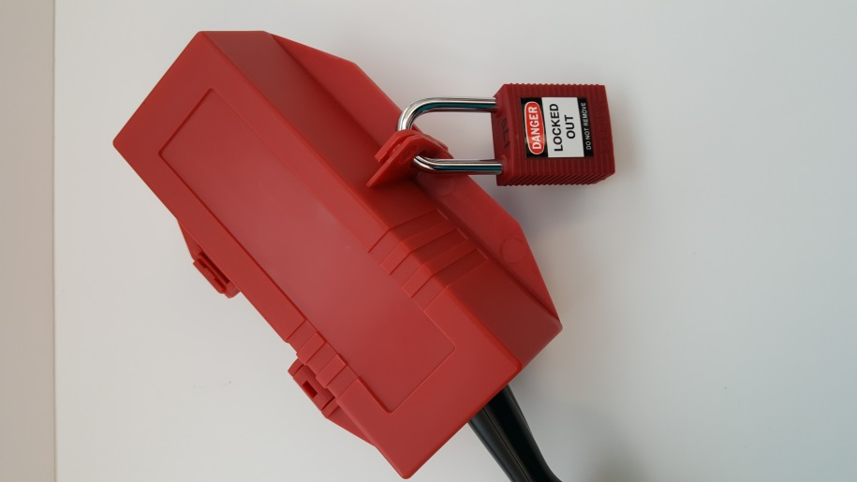
Large Plug Lockout

Slide 17
120/277V Clamp-on Single Pole Breaker Lockout
Click here to see how to install a clamp-on breaker lockout (without cleat).
Click here to see how to install the clamp-on breaker lockout (with cleat)
cleat

Slide 18
480/600V Clamp-on Single Pole Breaker Lockout
Installation is the same as for 120/277V Clamp-on breaker lockout.

Slide 19
Universal Multi-pole Breaker Lockout
Click here to see how to install the multi-pole breaker lockout.

Slide 20
Hasps
Click here to see how to use hasps.

Slide 21
How to perform LOTO
Communicate to all people who will impacted by the lock out that the lock out is required and why it is occurring.

Slide 22
How to perform LOTO
2. Identify ALL sources of energy that need to be isolated.

Slide 23
How to perform LOTO
3. Isolate the sources of energy to create a zero energy state:
Shut down or stop the machine or equipment.
I.e. depress stop button, flick switch to off, shut valve, open bleed valves, etc.
Unplug equipment from electrical source, if possible.
If not possible, flip the breaker switch providing power to the machine/equipment to the “OFF” position.
Release/block any stored or residual energy, including but limited to springs, elevated mechanisms, rotating parts, air/gas/steam/water pressure, etc.

Slide 24
How to perform LOTO
4. Lock-out & Tag-out
Place appropriate lock out device AND your assigned lock on the energy source.
Place a tag on the lock out. The tag should include your name and the date.
Under no circumstances whatsoever are the lock and lock-out device(s) to be removed or cut off by any person other than the person who performed the lock-out without following the “Forced Lock Removal Procedure”.

Slide 25
5. Verify zero energy:
Before beginning any work, test (turn to “ON” position) the machine or equipment to ensure it will not operate.
IMPORTANT: The machine or equipment must be returned to the “OFF” position after verification.

Slide 26
6. Perform maintenance, adjustments, cleaning and/or repairs as required.
The machine or equipment must be locked-out during the entire time that it is out of service.
If a contractor is needed to complete the necessary work, communicate with the appropriate facilities team member to assist with this process. A transfer of locks may be required in this situation.

Slide 27
How to perform LOTO
7. Restore machine or equipment back to service:
Once work is completed, ensure that all people in the area are safety positioned.
Remove all locks, tags and lock-out devices
Ensure all guards are in place
Re-energize back to working order

Slide 28
How to perform LOTO
8. Communicate to all people who will impacted by the lock out that the work and lock-out procedure is complete, and the equipment can now be used.

Slide 29
Remember:
Lock-out/tag-out is to be performed whenever a machine or piece of equipment is cleaned, maintained, adjusted or repaired.
A lock-out is done to protect others from injury due to unintentional release of energy while servicing/working on a machine, device or thing.
Tech teacher requests for LOTO kit replacement/additional parts should be directed to the Technology IPL.
Caretaker requests for LOTO kit replacement/additional parts should be directed to the Field Supervisor.

