Slide 1
NTIP New Teacher Induction Program
2018/2019

Slide 2
WELCOME
to the
Halton District School Board

Slide 7
Contacts
Superintendent of Education
Cristina Salmini
System Principal, Leadership and Staff Development
Laurie Reid
Executive Assistant
Suzanne Pierce

Slide 8
Learning Goals for NTIP Orientation
Learn about the supports offered for 2018/2019
Understand the process for booking NTIP time
‘Meet’ support staff and learn about Halton

Slide 9
Four Core Goal Areas of NTIP
Confidence
Efficacy
Instructional Practice
Commitment to Continuous Learning

Slide 11
Overview of the
Ontario NTIP Program
NTIP supports the growth and professional development of new teachers
New teachers are all teachers certified by the Ontario College of Teachers (OCT), who have been hired into permanent positions (part-time & full- time)
LTO teachers (in their first assignment that is 80 or more consecutive days), are included in NTIP

Slide 12
Who Qualifies for the
HDSB NTIP Program in 2017/2018?
All certified new teachers hired into permanent positions (full or part time) with less than 1 year of experience
Experienced teachers new to teaching in a public school in Ontario
Any LTO teacher in his/her first long-term assignment, (> 80 consecutive school days) as a substitute for the same teacher.
NO TPA

Slide 13
What About LTO Teachers?
If 1st LTO > 80 days definitely included
If participated as LTO last year but only for part of program then can be included (by request)
If participated as LTO last year for entire program and now permanent – can participate for one more year
If participated as LTO last year for entire program and now LTO again, will not participate again until permanent
TPAs not done for LTOs, LTO Appraisal only as per HR appraisal chart

Slide 14
Components of the
NTIP Program in Halton
System Orientation
School Orientation
Professional Development
Mentoring
Classroom Observation
TPA
All components must be recorded on the NTIP Individual Strategy Form.
The NTIP Individual Strategy Form is located in mVal.

Slide 15
NTIP Strategy - Permanent/LTO
If you are a permanent teacher you have access to mVal. If you are on an LTO, then complete your form information in a word document and save it until you have permanent status. At that time you will input the information into mVal.
Notes:
Should this be changed to google doc? A lot of teacher computers don’t have MS Office installed

Slide 16
Locating your NTIP Strategy Form in mVal
Go to myHDSB.
Go to Applications across the top of the screen, and select mVal from the drop-down options.
Log in to mVal using your Board user name and your password (if you have created one). If you cannot remember your password, you can select lost password and receive a new one via email. If you are logging in for the first time, enter user name and click lost password. You will receive an email with a password.
Click on the mVal logo on the home page.
Select “New ALP - NTIP Strategy Form”. Be sure to select NTIP Strategy Form in the drop-down menu on the next screen.
Each time you enter mVal you can select which plan you want to view or add to including your NTIP Strategy form, and your Annual Learning Plan (ALP) which is required AFTER you finish NTIP.
Please review Page #12 of the NTIP manual for additional step by step instructions.

Slide 17
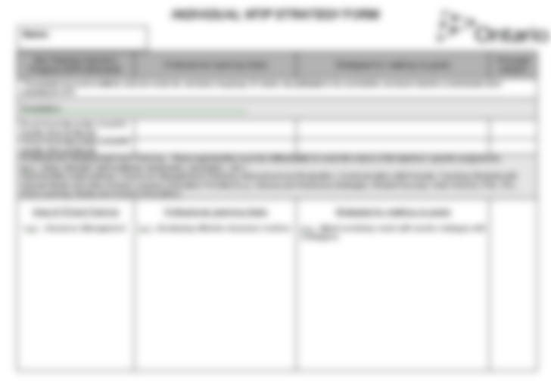
LTO teachers will not have access to mVal and will need to keep a personal copy of the strategy form.
Permanent teachers will have access to mVal and will need enter all strategy data directly into mVal.

Slide 18
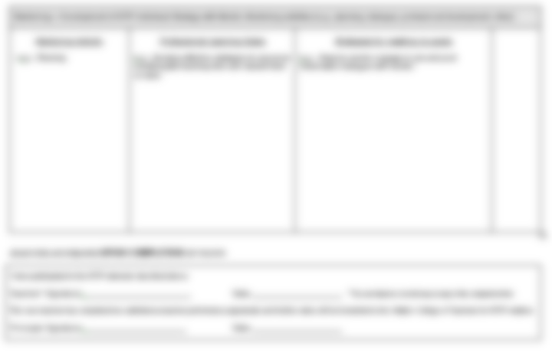
Use the strategy form to plan and record the professional learning that you are engaged in. Plans should be developed in consultation with your mentor and administrator. Record today’s orientation, learning community sessions, other professional learning and all time spent with your mentor.
NTIP Strategy forms must be completed and signed electronically with two completed satisfactory TPA’s to fulfill requirements of NTIP.

Slide 19
NTIP Component -
System Orientation
Click completed - get it into your Strategy Form.

Slide 20
NTIP Component -
School Orientation
In-School Orientation:
Your principal will arrange a time to meet with you
Your school principal will follow a checklist identifying key elements
Your principal will connect you to a mentor

Slide 21
NTIP Component -
Professional Development
New Teacher Learning Community Sessions
In school professional learning – PD days, staff meetings, division meetings
Other Board organized Professional Learning

Slide 22
Professional Development
Learning specific to needs of new teachers:
Classroom management
Planning, assessment, evaluation
Communication with parents
Teaching students with Special Needs
Current Education Priorities (e.g. Literacy and Numeracy strategies, Pathways, Student Success, Safe Schools)

Slide 23
New Teacher
Learning Communities
Each NTIP teacher will be assigned to a new teacher learning community
Groupings for the communities are by division, and/or subject
Each learning community will meet approximately 4-5 times per year
Additional opportunities for professional development will be provided throughout the year

Slide 24
Program Leaders for
Learning Communities
Kindergarten: Leslie Vande Kamp
Primary: Yvonne Messenger
Junior: Ian McLain
Intermediate: Tracy Wheatley-Romano Secondary: Tanya Williamson
French: Wendy Wright-Pettersen
Secondary French: Jeffery Yull

Slide 30
Process For Using NTIP Release Time
Sign up for all learning community sessions on PD Place
Book ½ days for New Teacher Learning Communities and for Job Embedded work using SMART FIND code 4700 (permanent) or 4701 (LTOs).
For community sessions and professional development outside of your school you must sign the sign in sheet
For self directed release time with your mentor you must each complete a REFLECTION FORM - without the submission of a reflection form your school will be billed for the release time.
Forms on myHDSB.
Page 13-14

Slide 31
Reflection Form
Every time you meet with your mentor, you must complete and submit a reflection form.
In order to use release time it is mandatory to do a reflection form.
Go to myhdsb.ca
Departments
Leadership and Staff Development
New Teacher Induction Program
NTIP Forms

Slide 32
Reflection Forms
Each new teacher, mentor, host teacher must fill out a reflection form each time they use release time for mentoring or classroom observation
Reflection forms do not need to be filled out for attendance at the learning community sessions

Slide 33
Mentoring
“It takes a community to induct a new teacher.”
“The mentor relationship is one of the most developmentally important relationships a person can have in early adulthood.”
Daniel Levinson
Seasons of a Man’s Life

Slide 34
Mentoring
Each new teacher will be matched with a mentor by the principal
A master list of all mentor and mentee matches is kept centrally
½ day of release time for both new teacher and mentor throughout year – job embedded application suggested in learning community sessions
Training and support for mentors provided by mentor team

Slide 35
NTIP Component -
Teacher Performance Appraisal (TPA)
Two Appraisals (two scheduled visits per appraisal)
Three Domains:
Commitment to Pupils and Pupil Learning
Professional Knowledge
Teaching Practice
In order to meet the requirements of NTIP:
You must have two satisfactory TPA’s completed and signed in mVal plus your NTIP Strategy Form.

Slide 36
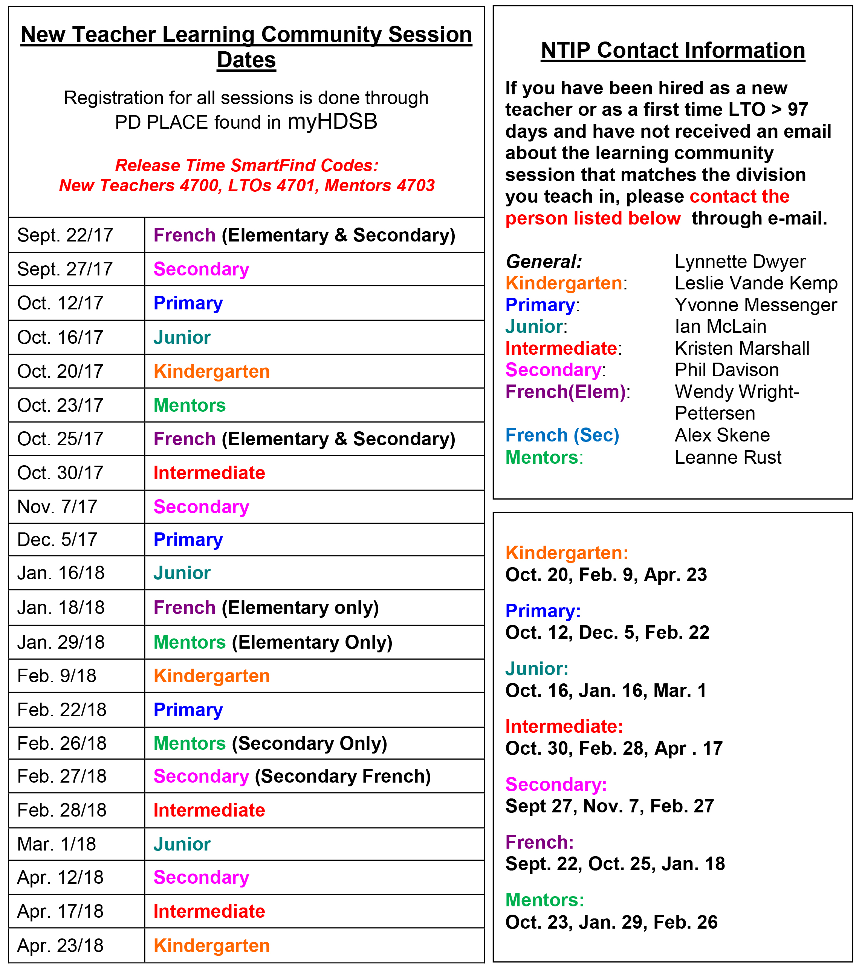
Page 8

Slide 37
Who can you call?

Slide 38
Thank You!

Slide 39
IMPORTANT!
Now that you have completed this training module, click the confirm button below to submit the certificate of completion to our database.
CONFIRM

