Slide 1
HDSB Anaphylaxis Training
In compliance with
PPM 161: Supporting Children and Students with Prevalent Medical Conditions (2018)
and
An Act To Protect Anaphylactic Pupils, 2005
(also know as, Sabrina’s Law)
Notes:
Welcome to the Supporting Students with Anaphylaxis Training Module. This module is in compliance with PPM 161 Supporting Children and Students with Prevalent Medical Conditions (2018), and, An Act To Protect Anaphylactic Pupils, 2005. Also known as, Sabrina’s Law

Slide 2
Sabrina’s Law
Sabrina Shannon, a grade 9 student
She died after eating French fries
in the school cafeteria
Her EpiPen was in her locker
Notes:
Sabrina Shannon, a grade 9 student from Pembroke, had a severe allergy to dairy products
She died after eating French fries, possibly cross contaminated with a cheese product, in the school cafeteria; her EpiPen
was in her locker.
Sabrina’s Law legislation is intended to protect students with anaphylaxis while at school.

Slide 3
PPM 161:Supporting Children and Students with Prevalent Medical Conditions
HDSB Supporting Students with Anaphylaxis Administrative Procedure
Anaphylaxis Plan of Care
Annual training
Notes:
More recently, PPM 161 Supporting Children and Students with Prevalent Medical Conditions was released in October 2017 and came into effect in September 2018.
All schools are required to have a plan to support students with anaphylaxis and, more specifically, develop a Plan of Care for each child with anaphylaxis

Slide 4
Anaphylaxis
is a sudden, severe, potentially life-threatening allergic reaction that may involve the skin, respiratory tract, gastrointestinal tract and/or cardiovascular system.
Notes:
Anaphylaxis is a serious and possibly life-threatening allergic reaction that requires immediate recognition medical emergency measures to be taken.
The Halton District School Board is committed to providing direction to school administrators, staff, students and parents / guardians about the appropriate response on both a school-wide and individual level to minimize the inherent risks to students and others who are identified as being susceptible to anaphylactic reactions due to individual allergic conditions.
The specific roles and responsibilities of staff, students, parents/guardians and administrators are detailed in the Administrative Procedure: Supporting Students with Anaphylaxis and should be reviewed regularly.

Slide 5
Common Causes of Anaphylaxis
Food – peanut, tree nuts, shellfish, fish, milk, egg, soy, sesame seed, wheat
Medications
Insect Venom
Latex
Immunotherapy (allergy shots)
Notes:
Allergies occur when your immune system becomes unusually sensitive and overreacts to common substances such as pollen, mould, dust or food. When these substances cause an allergic reaction, they are called allergens.
Food is one of the most common allergens that causes anaphylaxis, but insect stings, medications, latex and exercise (alone or sometimes after eating a specific food) can also cause reactions.
More than 1 million Ontarians are affected by a food allergy. There are about 138,000 students in Ontario with food allergies.
There is no cure for food allergy, so avoidance is still the main way to prevent an allergic reaction.

Slide 6
Anaphylactic reactions can occur in the:
upper respiratory system
lower respiratory system
skin
digestive system
as a generalized reaction called anaphylaxis
Notes:
Symptoms of an anaphylactic reaction can vary from person to person and may include:
Skin: hives, swelling (face, lips and tongue), itching, warmth, redness
Breathing (respiratory): coughing, wheezing, shortness of breath, chest pain/tightness, throat tightness, hoarse voice, nasal congestion or hay fever-like symptoms (runny, itchy nose and watery eyes, sneezing), trouble swallowing
Stomach (gastrointestinal): nausea, pain/cramps, vomiting, diarrhea
Heart (cardiovascular): paler than normal/blue skin colour, weak pulse, passing out, dizziness or light-headedness, shock
Other: anxiety, sense of “doom” (the feeling that something bad is about to happen), headache, uterine cramps, metallic taste

Slide 7
When is anaphylaxis most likely to occur?
New situations
Normal daily routines are interrupted
During teenage years
Notes:
All children at risk for anaphylaxis — no matter how independent they are — need the support of trusted, caring adults at school and elsewhere. Particularly when faced with new situations or a change in routine. Teenagers can be particularly at risk because they have greater independence, more relaxed precautions and can be reluctant to carry their EpiPen.
Sabrina’s Law and PPM 161 requires all district school boards in Ontario to have an anaphylaxis policy in place to support students with potentially life-threatening allergies.
Anaphylaxis can cause a great deal of anxiety for students, families, teachers and other school staff. When speaking to children about anaphylaxis, it is important that they know you are comfortable talking about the issue, or they may keep questions or concerns private. Ongoing communication between the school, the student and the family is essential, beginning when a student is diagnosed and starts school. Maintaining an open exchange of information is also important throughout the school year, especially if there are changes to the child’s medical condition.
Families should work with the school to create an individualized Plan of Care for their child. The plan will include support strategies or ways to accommodate the student so that they can participate to their full potential in school activities.

Slide 8
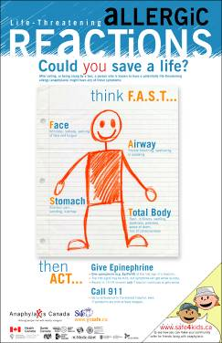
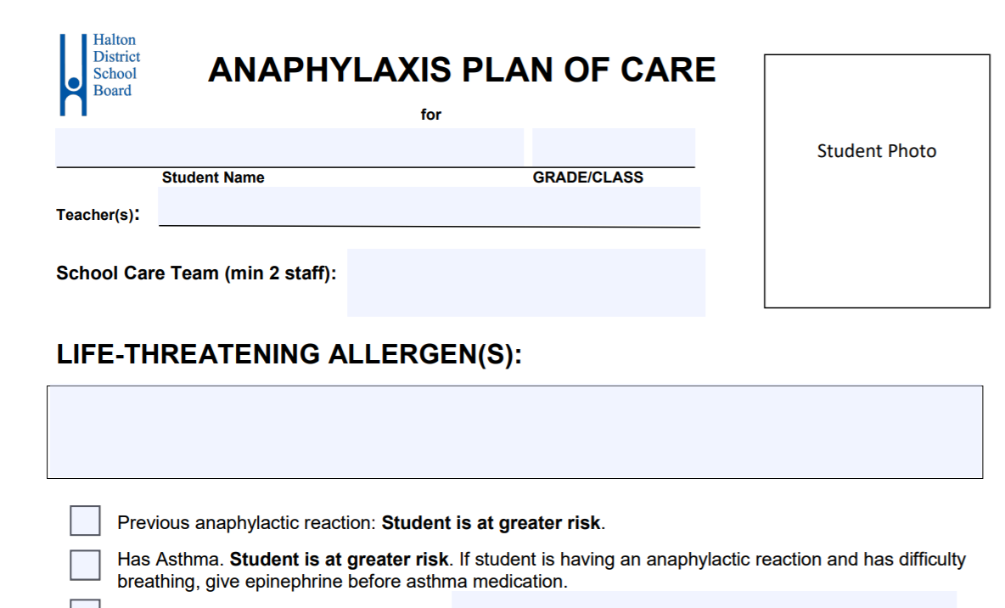
An Anaphylaxis Plan of Care
Location of two auto-injectors (one is always carried by student)
Safety measures to reduce risk
Symptoms of an anaphylactic reaction
Emergency medical response
Notes:
The Anaphylaxis Plan of Care is a form that contains individualized information on the student’s allergy, preventative strategies to reduce risk, symptoms of an anaphylactic reaction, location of medication and emergency medical response. Preventative strategies should include both awareness and avoidance measures.
The Anaphylaxis Plan of Care shall be co-created, reviewed or updated by the parents / guardians in consultation with the principal, designated staff and the student within the first 30 days of the school year or as soon as possible upon registration or diagnosis.
A School Care Team, with a minimum of two staff, will be identified on the Anaphylaxis Plan of Care. Specific responsibilities of the School Care Team in supporting, monitoring and responding to an anaphylactic emergency will be delineated. The School Care Team will receive student-specific training by the principal and/or parent on the implementation of the Anaphylaxis Plan of Care.
Parents have the authority to designate who is provided access to the Anaphylaxis Plan of Care. With authorization from parents / guardians, the Anaphylaxis Plan of Care will be:
i. Shared with appropriate school staff and others who are in direct contact with students with anaphylaxis (e.g. food service providers, transportation providers, volunteers).
ii. Posted in a key area of the school where staff have access on a regular basis.
iii. Posted inside the food preparation area of the cafeteria.
iv. Located in the educator’s daybook and/or occasional educator plans.

Slide 9
Think F.A.S.T.
F – FACE: itchiness, redness, swelling of face and tongue
A – AIRWAY: coughing, trouble breathing, swallowing or speaking
S – STOMACH: stomach pain, vomiting, diarrhea
T – TOTAL BODY: hives, rash, swelling, weakness, paleness, sense of doom, loss of consciousness
Notes:
In the event of a suspected anaphylactic emergency, think F.A.S.T.
Look at symptoms on the:
FACE such as itchiness, redness, swelling of face and tongue
AIRWAY: coughing, trouble breathing,swallowing or speaking
STOMACH: stomach pain, vomiting,diarrhea
TOTAL BODY: hives, rash, swelling, weakness, paleness, sense of doom, loss of consciousness

Slide 10
Emergency Response Plan
A.C.T.
A.: Administer the epinephrine auto -injector
C.: Call 911 – use the term Anaphylactic Reaction
T.: Transport to hospital by ambulance
Notes:
“Emergency” is defined by the Health Care Consent Act, 1996 to include a situation where the individual is experiencing severe suffering, or is at risk of sustaining serious bodily harm, if the treatment is not administered promptly. All staff are required to be trained annually in the emergency response to an anaphylactic reaction.
The individualized response to a student’s anaphylactic emergency shall be detailed in their Anaphylaxis Plan of Care. Staff who are in direct contact with the student, and those identified on the School Care Team, shall review and be trained on the Anaphylaxis Plan of Care.
Generally, in the event of an emergency, staff shall:
i. Give an epinephrine auto-injector (e.g., EpiPen®) at the first sign of known or suspected anaphylactic reaction.
ii. Call 9-1-1. Tell them someone is having a life-threatening allergic reaction.
iii. Call, or direct another adult to call, the emergency contact person.
v. Give a second dose of epinephrine as early as five (5) minutes after the first dose if there is no improvement in symptoms.
v. Transport the student to the hospital by ambulance, even if symptoms are mild or have stopped. The reaction could worsen or return, even after treatment.
vi. Provide the used auto-injector to the paramedics for safe disposal.
vii. Complete a Medical Emergency Record and an OSBIE Student Incident Report.

Slide 11
Remember…
It takes only 1 to 2 minutes for a mild allergic reaction to escalate to anaphylaxis.
Notes:
Remember...It takes only 1 to 2 minutes for a mild allergic reaction to escalate to anaphylaxis.

Slide 12
Legal Liability
Section c.7 s.3 (4) of the legislation ensures that no damages will be instituted with respect to any act done in good faith in response to an anaphylactic reaction.
Notes:
Both The Good Samaritan Act and Sabrina’s Law protects individuals from liability with respect to voluntary emergency medical or first aid services. Specifically, Sabrina’s Law states that no action for damages shall be instituted respecting any act done in good faith or for any neglect or default in good faith in response to an anaphylactic reaction in accordance with this Act, unless the damages are the result of an employee’s gross negligence.

Slide 13
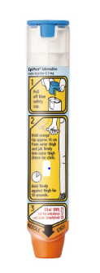
What is an EpiPen?
An EpiPen is a disposable drug delivery system with a spring-activated, concealed needle designed for emergency administration.
EpiPens are available in 2 strengths:
EpiPen Jr A smaller amount of epinephrine for children weighing less than 33 to a maximum of 66 lbs.
EpiPen A larger amount of epinephrine for anyone weighing more than 66 lbs.
Notes:
EpiPens are an effective way to administer a drug called Epinephrine (Adrenaline) through a disposable drug delivery system with a spring-activated, concealed needle designed for emergency administration.
EpiPens are available in 2 strengths:
EpiPen Junior - for children up to 66lbs
EpiPen - a larger dosage for those weighing more than 66lbs
Epinephrine by injection is the treatment of choice for anaphylactic reactions.
Epinephrine works quickly to:
constrict blood vessels
relax smooth muscles in the
lungs to improve breathing
stimulate the heart beat
reverse hives and swelling
around the face and lips.

Slide 14
Using an Epi-Pen
Administering an EpiPen is a simple two-step process:
Remove blue safety cap by pulling straight up. Do not bend or twist.
Swing or push orange firmly into mid-outer thigh until you hear a “click.” Hold on thigh for several seconds.
Notes:
Administering an EpiPen is a simple two-step process:
Remove blue safety cap by pulling straight up. Do not bend or twist. Never put fingers over the needle tip when removing the safety cap, or after the safety cap has been removed.
Swing or push orange firmly into mid-outer thigh until you hear a “click.” Hold on thigh for several seconds.
Be sure to give the used auto-injectors to the paramedics for safe disposal, as well as to inform them how many EpiPens have been administered
Side effects of Epinephrine include:
Nervousness
Increased heart rate
Sweating
Nausea / Vomiting
Headache
Dizziness
Periodically check the expiry date and condition of stored auto-injectors.
Keep auto-injectors at room temperature. Do not expose them to extreme cold, heat or direct sunlight.

Slide 15
Supporting Students wtih Anaphylaxis Administrative Procedure
Posted on the board website@ www.hdsb.ca
Also posted in myHDSB, along with supporting resources for staff
Notes:
It is important to review regularly the HDSB Supporting Students with Anaphylaxis Administrative Procedure posted on the board website@ www.hdsb.ca
It is also posted in myHDSB, along with supporting resources for staff.

Slide 16
For More Information
Anaphylaxis Canada
www.anaphylaxis.org
www.eworkshop.on.ca/allergies
Food Allergy and Anaphylaxis Network
http://www.foodallergy.org
Safe for Kids
http://www.safe4kids.ca
Health Canada
www.hc-sc.gc.ca
Allergy Asthma Information Association
www.aaia.ca
Notes:
For more information on anaphylaxis, please visit these sites.

