Slide 1
Supporting Students with
Diabetes
Notes:
Welcome to Supporting Students with Diabetes training module.
This training module is intended for all Halton District School Board personnel, and fulfils the requirements outlined in the Ontario Ministry of Education Policy/Program Memorandum No. 161: SUPPORTING CHILDREN AND STUDENTS WITH PREVALENT MEDICAL CONDITIONS.
This online training module compliments the HDSB Administrative Procedure: Supporting Students with Diabetes. The Administrative Procedure outlines the roles and responsibilities of students, families, school staff and the Halton District School Board as we work together to ensure the safety and wellbeing of students with diabetes. This administrative procedure can be found on myHDSB.ca under Student Health.

Slide 2
Diabetes Training Overview
Content
Video 1: Type 1 Diabetes - The Basics for School Staff
Video 2: Type 1 Diabetes - Low Blood Sugar at School (Hypoglycemia)
Overview: Hyperglycemia
Notes:
This diabetes training module is intended to inform viewers of the underlying causes of diabetes, the daily routines students with diabetes navigate, the steps necessary to support an individual in an emergency situation caused by low blood sugar, and the support required in situations of high blood sugar.

Slide 3
Type 1 Diabetes
The Basics for Teachers & School Staff
Type 1 Diabetes: The Basics for School Staff
Notes:
This two minute video provides basic details about the causes, prevalence, and treatment of diabetes. As well, factors that impact day to day routines of individuals with diabetes are highlighted.

Slide 4
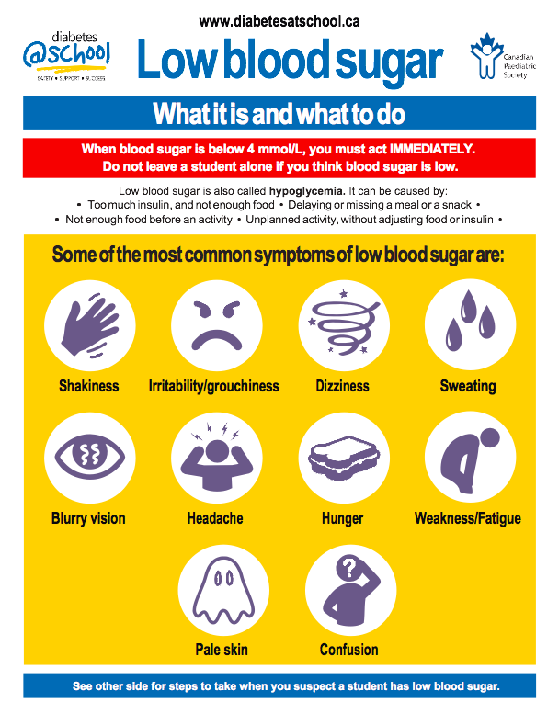
Hypoglycemia
Low Blood Sugar at School
Type 1 Diabetes: Low Blood Sugar at School
Notes:
Hypoglycemia, occurs when an individual with diabetes experiences low blood sugar levels. Hypoglycemia can put an individual at risk of sustaining serious bodily harm if treatment is not administered promptly.
This video provides an overview of causes and symptoms of hypoglycemia, and emergency steps to take if you suspect a student is experiencing hypoglycemia.
(CLIP VIDEO AT 2:19)

Slide 5
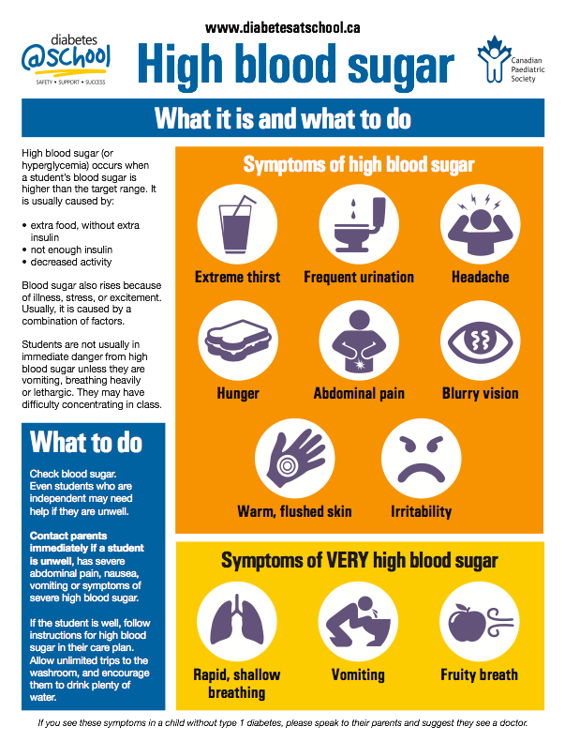
Hyperglycemia
High Blood Sugar
CALL 911
Notes:
High blood sugar (or hyperglycemia) occurs when a student’s blood sugar is higher than the target range. It is usually caused by:
• extra food, without extra insulin
• not enough insulin
• decreased activity
Blood sugar also rises because of illness, stress, or excitement. Usually, it is caused by a combination of factors.
Symptoms of high blood sugar can include increased thirst, more frequent urination, headache, hunger, abdominal pain, blurry vision, warm, flushed skin and irritability. Additionally, students may have difficulty concentrating in class.
If the student is well, allow unlimited trips to the washroom, and encourage them to drink plenty of water. Contact the parents immediately if a student is unwell, has severe abdominal pain, nausea, or is vomiting.
Students are not usually in immediate danger from high blood sugar unless they are vomiting, breathing heavily
or lethargic. In this instance, call 911 immediately, and then the parents.

Slide 6
CLICK CONFIRM
Notes:
This completes the training module: Supporting Students with Diabetes. For school based personnel who are an identified member of a ‘Care Team’ of a student with Diabetes, additional, student specific training will be provided at the school level.
Please click the confirm button to ensure your training is registered in the system.

