Slide 1



WHMIS
(Workplace Hazardous Materials Information System)
The basics

Slide 2


OVERVIEW
The Workplace Hazardous Materials Information System (WHMIS) provides information about many hazardous materials used in the workplace. WHMIS calls these hazardous materials controlled products.
Under WHMIS, workers have the right to receive information about each controlled product they use – its identity, hazards, and safety precautions. The goal of WHMIS is to reduce injury and disease by communicating specific health and safety information about controlled products so that the information can be used to reduce exposure to hazardous materials.

Slide 3



Federal and Provincial Legislation
1
Controlled Products
2
Ingredient Disclosure List
4
Hazardous Materials Information Review
3
Hazardous Materials Information Review Act
The Federal WHMIS legislation came into effect on October 30, 1988 under the Hazardous Products Act and four other pieces of federal legislation.
WHMIS came into effect in Ontario on October 31, 1988 as a Regulation under the Occupational Health and Safety Act (OHSA). In Ontario, the WHMIS Regulation applies to all workplaces that are covered by the OHSA and is enforced by the Ministry of Labour. The federal workplaces are inspected by Labour Canada, which enforces WHMIS under its jurisdiction.

Slide 4



3 Basic Elements of WHMIS
WHMIS Labels
2. Material Safety Data Sheets (MSDS)
3. WHMIS Training and Education
Labels on controlled products alert workers to the identity of the product, hazards, and precautionary measures.
Technical bulletins which provide detailed hazard and precautionary information.
The employer provides education and training for workers so that they can work safely with and near controlled products. Workers need to know how WHMIS works, the hazards of controlled products in their workplace, and the safe work procedures they must follow.

Slide 5
Key WHMIS Participants
SUPPLIERS
EMPLOYERS
WORKERS
Classify all controlled products
Supply proper labels and MSDS
Keep information on labels and MSDS current
Educate and train workers
Provide safe work procedures
Ensure availability of proper up-to-date labels and MSDS
Understand content and significance of labels and MSDS
Follow safe work procedures and WHMIS requirements
Notify employers about problems with labels and MSDS

Slide 6

WHMIS Elements
WHMIS controlled products are classified by their hazard.
There are six hazard classes and eight hazard symbols that identify the specific hazards (there are three symbols in Class D).
The eight hazard symbols identify the specific hazards of controlled products.

Slide 7

CLASS A: Compressed Gas
Gas under pressure
  Examples:
    Butane, propane, acetylene, and fire extinguishers
  Hazards:
    If a pressurized container is punctured because it is dropped or exposed to excessive heat, the exploding fragments or rocket-like projectiles present a serious physical hazard
    Heat may cause container to explode
    Container may explode if dropped

Slide 8

CLASS B: Flammable and Combustible Materials
May catch fire or explode
  Examples:
    Acetone, isopropyl alcohol, stoddart solvent
  Hazards:
    Flammables are more dangerous than combustibles because they ignite more easily
    During use, they must be kept away from ignition sources such as sparks or open flames
    When not in use, they must be stored in fire-resistant cabinets or other specified storage areas

Slide 9

CLASS C: Oxidizers
Products causing or contributing to the combustion of other materials
  Examples:
    Hydrogen peroxide, potassium nitrate, sodium chlorate
  Hazards:
    Oxidizing materials greatly increase the risk of fire if they come in contact with materials that can burn
    They should never be stored near flammable or combustible materials

Slide 10




CLASS D: Poisonous and Infectious Materials
This class has 3 divisions: D1, D2 and D3
D3:
Bio hazardous Infectious Material
D2:
Materials Causing Other Toxic Effects
D1:
Materials causing immediate and serious toxic effects

Slide 11

CLASS D1: Materials Causing Immediate and Serious Effects
Poisonous, may be fatal
  Examples:
    Arsenic, methylene chloride, formaldehyde
  Hazards:
    May be fatal if inhaled, swallowed or absorbed through skin
    May burn skin or eyes upon contact

Slide 12

CLASS D2: Materials Causing Other Toxic Effects
Poisonous, but not immediately dangerous to health
Chronic health effects on body organs, cardiovascular or nervous system
  Examples:
    Carcinogens (asbestos, crystalline silica, benzene) sensitizers (methyl methacrylate) embroyotoxin (xylene)
  Hazards:
    Repeated exposure may cause death or permanent injury
    May be a skin irritant or sensitizer causing allergic reaction
    May cause birth defects, cancer, reproductive problems, or impairment of body organs and systems

Slide 13

CLASS D3: Bio Hazardous Infectious Materials
May cause serious disease, resulting in death or illness
Classified as Risk Groups II, III or IV as defined by the Medical Research Council of Canada
  Examples:
    Commercial cultures containing infectious organisms such as HIV, Ebola, and Hepatitis B
  Hazards:
    Microorganisms (includes viruses, bacteria, fungi) can cause disease in persons and animals.
    They may be present in cultures.
    Products containing bio hazardous infectious materials may be found in laboratory and research facilities associated with the medical or agricultural sectors.

Slide 14

CLASS E: Corrosive Materials
Caustics or acids causing severe irritation and burns to skin or eyes
  Examples:
    Sodium hydroxide, hydrochloric acid, hydrofluoric acid
  Hazards:
    Corrosive materials can cause permanent damage (e.g., burns) to skin and eyes
    May be harmful if inhaled
    May eat through metal

Slide 15

CLASS F: Dangerously Reactive Materials
Products that can undergo dangerous reaction if subject to heat, light, pressure, shock, water or air
  Examples:
    Hydrogen cyanide, vinyl acetate, chlorine dioxide
  Hazards:
    Products in this class are very unstable
    They can undergo vigorous polymerization reaction on their own, or become self-reactive when exposed to shock or to increase in pressure or temperature
    It also includes products that react strongly with water to release a toxic gas

Slide 16
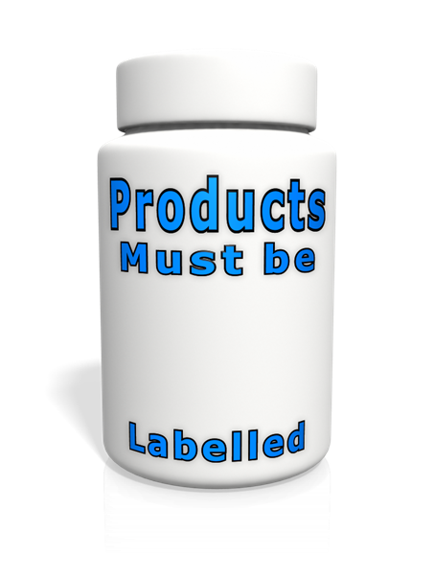
WHMIS Labels
The purpose of labels is to alert workers to the main hazards of controlled products and provide instructions for safe handling, and to direct workers to the MSDS for more information.
All WHMIS controlled products must be labelled
There are 2 types of WHMIS Labels
  Supplier Labels
  Workplace Labels
Other means of identification
  Placards, warning signs, colour codes
  Labels alert workers to hazards and safe handling instructions

Slide 17
Supplier Labels
Supplier Labels contain the following:
Product name
Hazard symbols
Risk phrases
Precautionary measures
First Aid measures
Supplier identifier
Reference to MSDS
All information must be disclosed in English and French within a hatched border
Suppliers must provide supplier labels on containers of all controlled products sold or imported for use in the workplace.
Supplier labels will show seven types of information within the WHMIS hatched border.
The label must be clearly separated by a border to stand out from the container itself and other markings on the container (i.e., the size of the label should be appropriate for the size of the container).

Slide 18
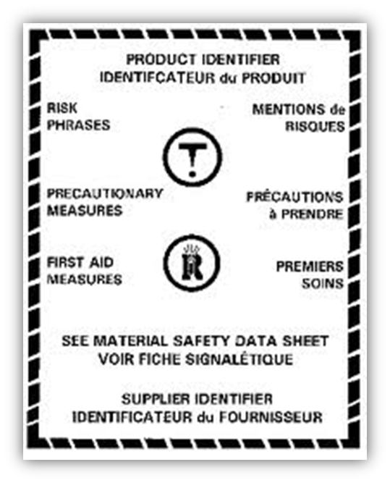
Acceptable Format for the Supplier Label
Product Identifier
Hazard Symbol(s)
Risk Phrases
Precautionary Statement(s)
First Aid Measures
Supplier Identifier
Reference to the MSDS
Hatched Border

Slide 19

Workplace Labels
Workplace labels are required on containers of controlled products produced on site, and on secondary containers where the product has been transferred from the original container.
  Workplace labels are applied to:
    Secondary containers
    Containers of products received in bulk
    Containers with missing or illegible supplier labels
  Workplace labels contain the following:
    Product name
    Safe handling procedures
    Reference to the MSDS

Slide 20
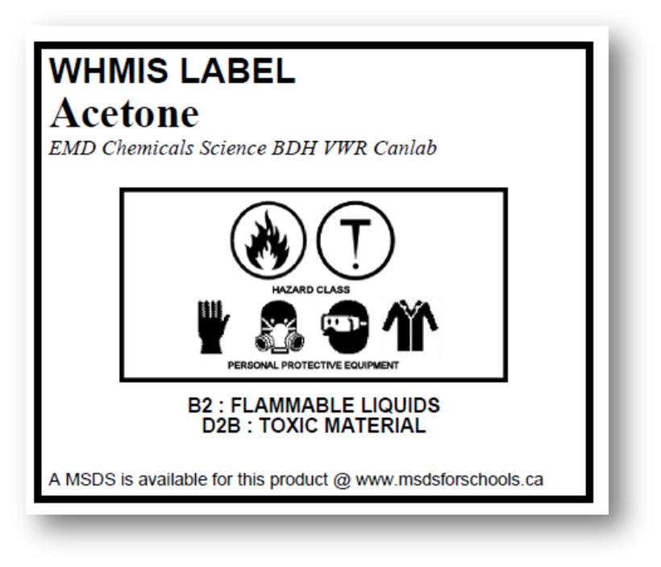
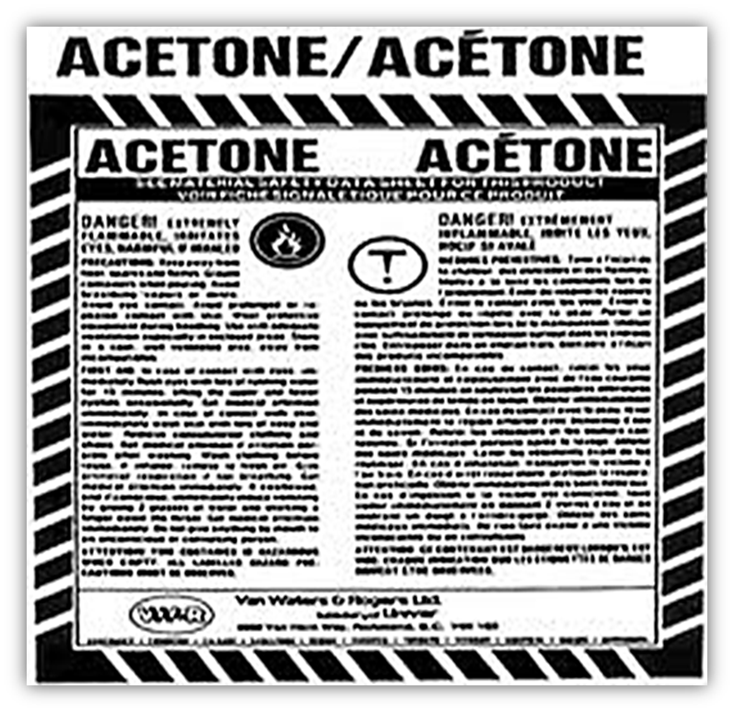
Examples of Labels
Supplier Label Example
Workplace Label Example

Slide 21
MSDS (Material Safety Data Sheet)
A Material Safety Data Sheet is a technical bulletin that provides specific hazard information, safe handling information, and emergency procedures for a controlled product. Since the MSDS contains detailed health and safety information specific to each controlled product, it should be used as a key source of information for developing training programs and safe work procedures. It is also a valuable source of health and safety information for workers, health and safety committees, and emergency service personnel.
Examples of information included:
Hazardous ingredients
Hazards (fire, explosion, reactivity)
Health effects of exposure (acute and chronic)
Hazard evaluation related to storage and handling
Measures to protect workers
Emergency procedures
MSDSs must be current (no more than 3 years old), complete, and readily available to workers
The MSDS must be made available and accessible to all workers.

Slide 22

Where to Find an MSDS
Employers may use an electronic database to store MSDSs. In this case, it is essential that workers are provided information on accessing such a database to retrieve an MSDS. A hard copy of the MSDS should always be on hand when working with a controlled product in case electronic files are not accessible (e.g., the system is down).
The MSDS:
Provides detailed information on the hazards of a controlled product
An important element for developing safe work procedures and control measures
A key element of worker education and training
Halton District School Board uses “MSDS Request” on MyHDSB to store electronic copies of all MSDS.

Slide 23




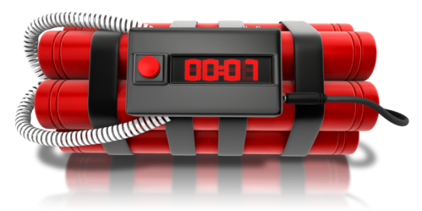
Partial Exemptions
Some products are already covered by other labelling legislation and do not require WHMIS labels and MSDSs. However, Provincial legislation requires employers to educate and train workers about the hazards of partially exempt products, and safe work procedures. Partially exempt products still require Workplace Labels.
        No WHMIS Supplier Label and MSDS Required
      Education & Training and Workplace Labels Required
Examples:
          Some Consumer Products
          Cosmetics
          Food and Drugs
          Medical Devices
          Radioactive Substances
          Pesticides
          Explosives

Slide 24

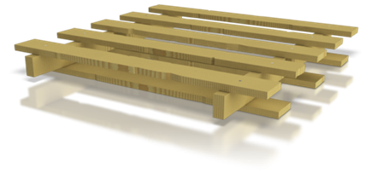
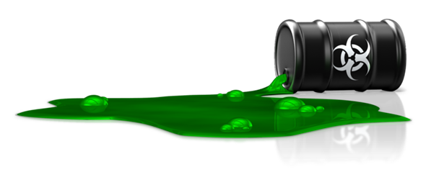
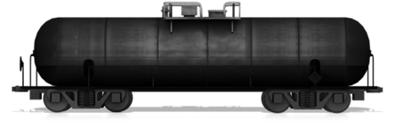
Complete Exemptions
Some products are completely excluded from both Federal and Provincial WHMIS requirements. However, workers must be advised of hazards and be trained in safe handling procedures, as required under other provisions of the Occupational Health and Safety Act.
None of the WHMIS Requirements Apply
    Examples
        Wood and Products made of Wood
        Manufactured Articles
        Tobacco and Tobacco Products
        Hazardous Wastes
        Goods Handled Under TDG
        Hazardous Materials in Transport

Slide 25


WHMIS and Consumer Products
Consumer products are typically packaged and used for personal and household purposes. Suppliers and employers do not have to comply with the WHMIS label and MSDS requirements for consumer products, but workers must understand the hazards and safe use of them. Although not legally required, most consumer products will have an MSDS available.
The obligation includes:
Ensuring that the worker has read and understood the consumer product labels.
Ensuring that the worker would recognize the different consumer product labels.
Ensuring that training is provided for the use, handling, storage and disposal of the consumer product(s).

Slide 26

WHMIS and Consumer Products
Partial exemption of WHMIS applies to the following conditions:
The product must be packaged in a size normally available to consumers in a retail outlet.
The product must be available to the general public; wholesale outlets are not considered to be available to the public.
The product must be labelled to comply with the requirements for hazardous consumer products.
Health and safety precautions must still be taken.
The employer’s training obligations apply to any consumer product containing controlled substances used in a workplace.

Slide 27
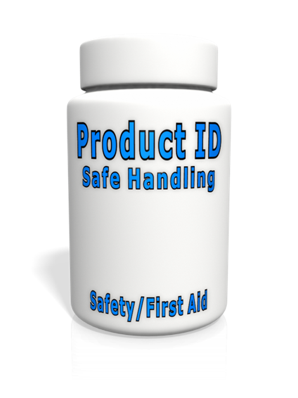
Consumer Product Labels
Labels on consumer products must appear in both English and French.
Hazard information must be clearly separated from the rest of the container by a border.
Most of the labels on products for consumer use sold in Canada meet the criteria set out for WHMIS workplace labels, namely:
          The product is identified and the supplier / manufacturer’s name and address are included
          Information is given on the safe handling of the product
          Safety information is on the label, including: hazard warnings, instructions and directions for First Aid

Slide 28




Consumer Product Categories and Symbols
Category 1: Toxic or Poisonous Substances
  The symbol used for all toxic materials is the skull & crossbones inside an octagonal border. The 8-sided border indicates “STOP” and take precautions listed on the label.
Category 2: Corrosive Substances
  The symbol used for all corrosive materials is the hand skeleton inside an octagonal border. The 8-sided border indicates “STOP” and take precautions listed on the label
Category 3: Flammable substances
  The symbol used for all flammable materials is a flame inside an octagonal border. The 8-sided border indicates “STOP” and take precautions listed on the label.
NO SYMBOL REQUIRED
Category 4: Quick Skin Bonding Adhesive
  Labels with specific warnings are required. The glue must be in a child-resistant container or enclosed in a child-resistant outer package.
Category 5: Pressurized Container
  The products bearing this symbol either contain a liquid or gas under pressure. Consumer products bearing this symbol will include aerosol cans. The symbol used for all pressurized containers is an exploding image in a triangle indicating “WARNING”. A label with specific warnings is required.

Slide 29
WHMIS Quiz
In order to complete the training, you must pass the following quiz.
You must get 100% on the quiz in order to pass the training.

Slide 30
What does WHMIS stand for?
A)
Workers Health Manual in Safety
B)
Workplace Hazardous Materials Information System
C)
Workplace Hazard Materials Investigation Service
D)
Workplace Health Management Information System
Correct - Click anywhere to continue
Incorrect - Click anywhere to continue
Your answer:
You answered this correctly!
You did not answer this question completely
Try again
You must answer the question before continuing
The correct answer is:
Submit
Clear

Slide 31
What are the most important aspects of WHMIS?
A)
Safety rules
B)
Hazardous materials
C)
Labels, MSDS and Education
D)
Wellness
Correct - Click anywhere to continue
Incorrect - Click anywhere to continue
Your answer:
You answered this correctly!
You did not answer this question completely
Try again
You must answer the question before continuing
The correct answer is:
Submit
Clear

Slide 32
What governing body enforces WHMIS legislation in Ontario?
A)
The Ministry of Labour
B)
The Ministry of Education
C)
The Ministry of Health and Safety
D)
Workplace Safety Board
Correct - Click anywhere to continue
Incorrect - Click anywhere to continue
Your answer:
You answered this correctly!
You did not answer this question completely
Try again
You must answer the question before continuing
The correct answer is:
Submit
Clear

Slide 33

What is the meaning of this symbol?
A)
Can cause death of a person exposed to small amounts
B)
Contain harmful microorganisms
C)
Can cause immediate skin or eye irritation or long-term health effects
D)
Can cause illness
Correct - Click anywhere to continue
Incorrect - Click anywhere to continue
Your answer:
You answered this correctly!
You did not answer this question completely
Try again
You must answer the question before continuing
The correct answer is:
Submit
Clear

Slide 34

What is the meaning of this symbol?
A)
Contain harmful microorganisms
B)
Capable of catching fire or exploding in the presence of ignition sources
C)
Provide oxygen that can increase the risk of fire
D)
Can cause a severe burn
Correct - Click anywhere to continue
Incorrect - Click anywhere to continue
Your answer:
You answered this correctly!
You did not answer this question completely
Try again
You must answer the question before continuing
The correct answer is:
Submit
Clear

Slide 35

What is the meaning of this symbol?
A)
Caustics or acids that can destroy skin or eat metals
B)
Will make your skin itch
C)
Can explode if exposed to heat or impact
D)
Wash hands and avoid touching surfaces
Correct - Click anywhere to continue
Incorrect - Click anywhere to continue
Your answer:
You answered this correctly!
You did not answer this question completely
Try again
You must answer the question before continuing
The correct answer is:
Submit
Clear

Slide 36

What does the border around this symbol mean?
A)
Danger
B)
Caution
C)
Warning
D)
Safe
Correct - Click anywhere to continue
Incorrect - Click anywhere to continue
Your answer:
You answered this correctly!
You did not answer this question completely
Try again
You must answer the question before continuing
The correct answer is:
Submit
Clear

Slide 37

What does this symbol stand for?
A)
A pirate treasure location symbol
B)
A consumer product symbol warning of a toxic or poisonous substance
C)
A supplier label symbol for warning of death to exposure
D)
A manufacturing symbol warning of death
Correct - Click anywhere to continue
Incorrect - Click anywhere to continue
Your answer:
You answered this correctly!
You did not answer this question completely
Try again
You must answer the question before continuing
The correct answer is:
Submit
Clear

Slide 38

What does this symbol stand for?
A)
Oxiders
B)
Corrosive material
C)
Dangerously Reactive material
D)
Flammable/Combustible material
Correct - Click anywhere to continue
Incorrect - Click anywhere to continue
Your answer:
You answered this correctly!
You did not answer this question completely
Try again
You must answer the question before continuing
The correct answer is:
Submit
Clear

Slide 39

What does this symbol stand for?
A)
Explosive material
B)
Bio hazardous infectious material
C)
Clean chemical container
D)
Acetone
Correct - Click anywhere to continue
Incorrect - Click anywhere to continue
Your answer:
You answered this correctly!
You did not answer this question completely
Try again
You must answer the question before continuing
The correct answer is:
Submit
Clear

Slide 40

What does this symbol stand for?
A)
Compressed gas
B)
Sterile containers
C)
Explosive containers
D)
Clean chemical container
Correct - Click anywhere to continue
Incorrect - Click anywhere to continue
Your answer:
You answered this correctly!
You did not answer this question completely
Try again
You must answer the question before continuing
The correct answer is:
Submit
Clear

Slide 41

This symbol refers to which hazard?
A)
Oxidizing materials greatly increase the risk of fire
B)
Materials may become self-reactive when exposed to an increase in pressure or temperature
C)
These materials can pose a danger of catching fire
D)
Campfires are okay here
Correct - Click anywhere to continue
Incorrect - Click anywhere to continue
Your answer:
You answered this correctly!
You did not answer this question completely
Try again
You must answer the question before continuing
The correct answer is:
Submit
Clear

Slide 42
What is the purpose of a WHMIS label?
A)
To alert workers to stop work immediately
B)
To keep an organized inventory
C)
To alert workers to hazards of controlled products
D)
To alert workers that the chemical is safe
Correct - Click anywhere to continue
Incorrect - Click anywhere to continue
Your answer:
You answered this correctly!
You did not answer this question completely
Try again
You must answer the question before continuing
The correct answer is:
Submit
Clear

Slide 43
What are the two types of WHMIS labels?
A)
Distributer label and employer label
B)
Manufacturer label and package label
C)
Supplier label and workplace label
D)
Manufacturer label and HDSB label
Correct - Click anywhere to continue
Incorrect - Click anywhere to continue
Your answer:
You answered this correctly!
You did not answer this question completely
Try again
You must answer the question before continuing
The correct answer is:
Submit
Clear

Slide 44
What does MSDS stand for?
A)
Manufacturer’s Safety Determination Standard
B)
Material Safety Data Sheet
C)
Management Saving Data System
D)
Managing Safety Descriptions System
Correct - Click anywhere to continue
Incorrect - Click anywhere to continue
Your answer:
You answered this correctly!
You did not answer this question completely
Try again
You must answer the question before continuing
The correct answer is:
Submit
Clear

Slide 45
Who should know where MSDSs are kept?
A)
Administrators and Supervisors only
B)
Custodial staff
C)
All workers
D)
Facilities Services Department
Correct - Click anywhere to continue
Incorrect - Click anywhere to continue
Your answer:
You answered this correctly!
You did not answer this question completely
Try again
You must answer the question before continuing
The correct answer is:
Submit
Clear

Slide 46
How often must an MSDS be updated?
A)
Every year and as soon as new information on a product is available
B)
Every 2 years and as soon as new information on a product is available
C)
Every 3 years and as soon as new information on a product is available
D)
Once a month
Correct - Click anywhere to continue
Incorrect - Click anywhere to continue
Your answer:
You answered this correctly!
You did not answer this question completely
Try again
You must answer the question before continuing
The correct answer is:
Submit
Clear

Slide 47
There are seven types of information on a supplier label. What answer below is false?
A)
Precautionary measures
B)
The recipe and ingredients
C)
Risk phrases
D)
First aid measures
Correct - Click anywhere to continue
Incorrect - Click anywhere to continue
Your answer:
You answered this correctly!
You did not answer this question completely
Try again
You must answer the question before continuing
The correct answer is:
Submit
Clear

Slide 48
What languages must appear on Supplier labels?
A)
English and French
B)
English and Italian
C)
English and Spanish
D)
All (English, Italian, French, Spanish)
Correct - Click anywhere to continue
Incorrect - Click anywhere to continue
Your answer:
You answered this correctly!
You did not answer this question completely
Try again
You must answer the question before continuing
The correct answer is:
Submit
Clear

Slide 49
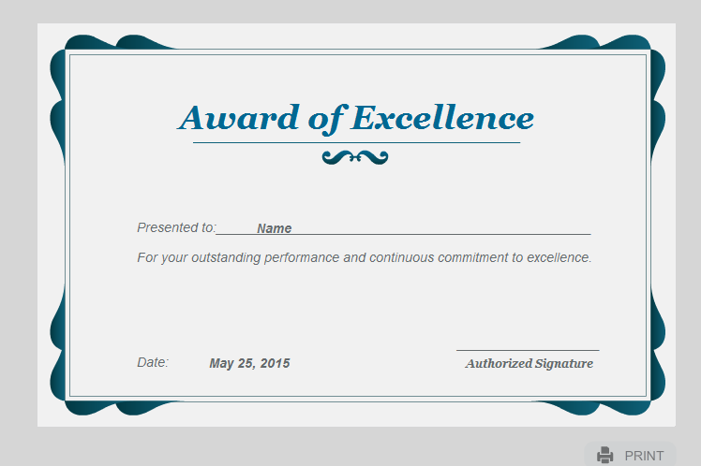

Slide 50
CONGRATULATIONS!!!
You have successfully completed the training and passed the WHMIS Quiz
IMPORTANT!!!
Now that you have completed this training, click the confirm button below to submit the certificate of completion to our database.
CONFIRM

